Slide 1
Instructor Materials Chapter 1: Introduction to the Personal Computer
IT Essentials v6.0
Notes:
Cisco Networking Academy Program
IT Essentials
Chapter 1: Introduction to the Personal Computer

Slide 2
Instructor Materials - Chapter 1 Planning Guide
This PowerPoint deck is divided in two parts:
Instructor Planning Guide
Information to help you become familiar with the chapter
Teaching aids
Instructor Class Presentation
Optional slides that you can use in the classroom
Begins on slide #10
Note: Remove the Planning Guide from this presentation before sharing with anyone.
Notes:
2

Slide 3
ITE 6.0 Planning Guide
Chapter 1: Introduction to the Personal Computer
Notes:
ITE 6.0 Planning Guide
Chapter 1: Introduction to the Personal Computer

Slide 4
Chapter 1: Activities
What activities are associated with this chapter?
The password used in the Packet Tracer activities in this chapter is:
Not applicable for this chapter.
Page Number | Activity Type | Activity Name
1.1.1.4 | Lab | Ohms Law
1.2.1.13 | Lab | Research Computer Components
1.3.1.7 | Lab | Build a Specialized Computer System
Notes:
4

Slide 5
Chapter 1: Assessment
Students should complete Chapter 1, “Assessment” after completing Chapter 1.
Quizzes, labs, Packet Tracers and other activities can be used to informally assess student progress.
Notes:
5

Slide 6
Chapter 1: Best Practices
Prior to teaching Chapter 1, the instructor should:
Complete Chapter 1, “Assessment.”
The concepts and topics covered here will follow the students through their IT career. Make sure to take your time to eliminate any misconceptions.
Computers can be broken down into three main parts: CPU, Memory and I/O. Build on this simple definition of a computer to explain and demystify modern and more complex computers.
Notes:
6

Slide 7
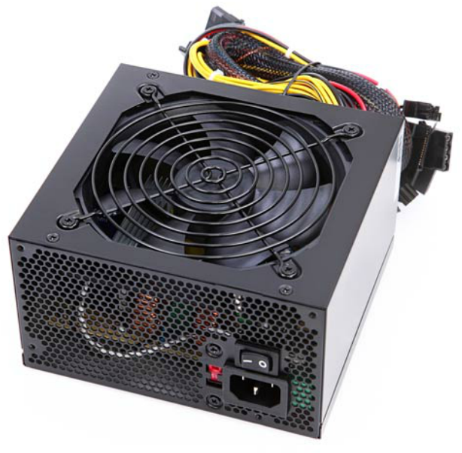
Chapter 1: Best Practices (Cont.)
This slide can be used to foment class discussion. It should help the students to understand the impact of each device in the overall computer power consumption.
Below are some common computer components and their average power consumption:
Motherboard 35W (low end) 75W (high end)
CPU 77W (low end) 120W (top end)
Memory 3W (low end) 4.5W (high end) *
Video Card(s) 70W(low end) 470W(top end)**
SSD Drive 1.5W
3.5 HDD Drive 7.5W
SATA Bluray Drive 30W
SATA DVD Drive 20W
80 mm Case Fan (2,000 RPM) 1.5W
(*) DDR3 memory operates with lower voltages; lower voltages lead to lower power consumption.
(**) under heavy operation.
A few devices still not accounted for are: USB drives without power supply, adapter cards, extra fans, etc
Notes:
7
1.1 - Personal Computer Systems
1.1.1 - Cases and Power Supplies

Slide 8
Chapter 1: Best Practices (Cont.)
The website hosted on the URL shown below has a power calculator. It could be helpful to allow students to get a better grasp on the power consumption requirements of computer components.
http://outervision.com/power-supply-calculator
Notes:
8
1.1 - Personal Computer Systems
1.1.1 - Cases and Power Supplies
This slide can be used to foment class discussion. It should help the students to understand the impact of each device in the overall computer power consumption.

Slide 9
Chapter 1: Additional Help
For additional help with teaching strategies, including lesson plans, analogies for difficult concepts, and discussion topics, visit the ITE Community at community.netacad.net.
If you have lesson plans or resources that you would like to share, upload them to the ITE Community in order to help other instructors.
Notes:
9

Slide 10
Chapter 1: Topics in chapter that are not found in the CompTIA A+ 220-901 Certification
This slide lists content included in this chapter that is NOT listed in the CompTIA A+ 220-901 blueprint. Instructors could skip these sections; however, they should provide additional information and fundamental concepts to assist the student with the topic.
All content in Chapter 1 is aligned to the certification.
Notes:
10

Slide 11


Slide 12
Chapter 1: Introduction to the Personal Computer
IT Essentials v6.0
Notes:
Cisco Networking Academy Program
IT Essentials
Chapter 1: Introduction to the Personal Computer

Slide 13
Chapter 1 - Sections & Objectives
1.1 Personal Computer Systems
Explain how personal computer systems work together
1.2 Select Computer Components
Select appropriate computer components
1.3 Configurations for Specialized Computer Systems
Explain how hardware is configured for task-specific computers
Notes:
13

Slide 14
1.1 Personal Computer Systems
Notes:
Cisco Networking Academy Program
IT Essentials
Chapter 1: Introduction to the Personal Computer

Slide 15
Personal Computer Systems Cases and Power Supplies
Cases
Influences the motherboard form factor choice
Must allow for good air flow
Available in different sizes
Power Supplies
Provides power to all computer components.
Must be chosen based on current and future needs.
Deliver different voltage levels to meet different internal component needs.
Power Supply Wattage
P = V x A
Notes:
1.1 - Personal Computer Systems
1.1.1 - Cases and Power Supplies

Slide 16
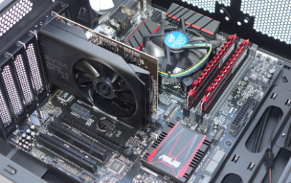
Personal Computer Systems Internal PC Components
Motherboards
Backbone of the computer
Interconnects computer components
CPU
The brain of the computer
Most processing is done by the CPU
Cooling Systems
Dissipates the heat generated by computer components.
Memory (ROM and RAM)
RAM: Stores data temporarily, aiding processing
ROM: Stores data permanently; often storing firmware and low level programs.
Notes:
1.1 - Personal Computer Systems
1.1.2 - Internal PC Components

Slide 17

Personal Computer Systems Internal PC Components (Cont.)
Adapter Cards and Expansion Slots
Adapter Cards extend computer functionality
Adapter Cards connect to the motherboard through Expansion Slots
Storage Devices
Designed to permanently store user data, user applications and the Operating System
Can be internal or external to the computer
Video Ports
Connects a video system to an external display device such as a monitor or projector
Video systems are often designed as an adapter card.
General Ports
Provide connectivity between the motherboard and various external devices such as printers, external storage and video cameras.
Notes:
1.1 - Personal Computer Systems
1.1.2 - Internal PC Components (Cont.)

Slide 18
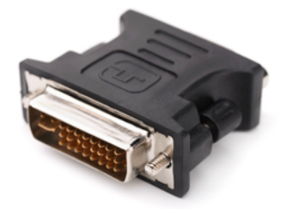
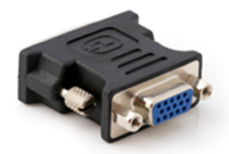
Personal Computer Systems External Ports and Cables
Video Ports and Related Cables
A few different standards govern video traffic between the computer and external video devices.
HDMI and displayPort are examples of video ports that require a specific cable to operate.
Other Ports and Related Cables
Motherboards have a number of other ports used for device connectivity; USB is a common example.
Adapters and Converters
Adapters and converters can be a solution if a motherboard does not have the proper port to connect to a device.
Adapters do not usually process the signal; they simply redirect it to another pin.
Converters are more likely to process and transform the signal, converting it to be accepted by an existing port.
Notes:
1.1 - Personal Computer Systems
1.1.3 - External Ports and Cables

Slide 19
1.2 Select Computer Components
Notes:
Cisco Networking Academy Program
IT Essentials
Chapter 1: Introduction to the Personal Computer

Slide 20
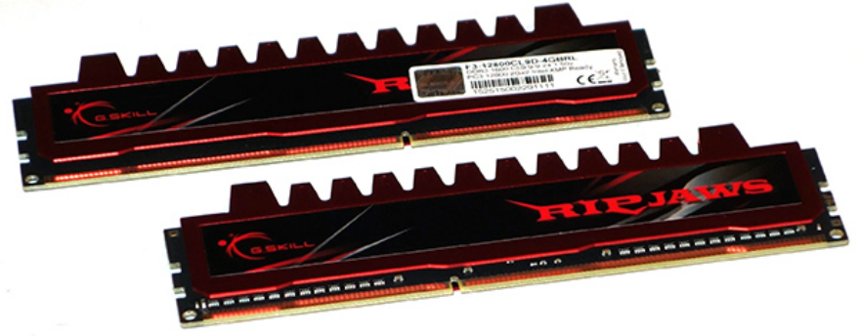
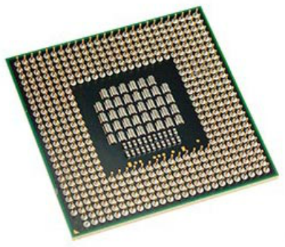
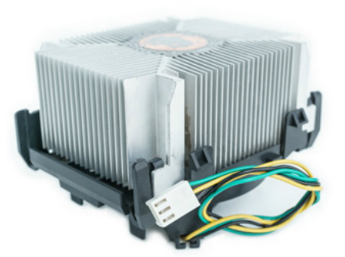
Select Computer Components Select PC Components
Select the Motherboard, CPU, Case and Memory
CPU, memory, motherboard and case choices are inter-related.
The motherboard should support all customer required applications and still fit properly in the case.
The case should host the motherboard, the proper power supply and provide good airflow for the internal components.
The CPU must be compatible with motherboard CPU slot and voltage; it should be compatible with the chosen memory speed for maximum performance.
The memory must also be compatible with motherboard memory slots and voltage.
The amount of memory will depend on the type of applications requested by the customer.
Notes:
1.2 - Select Computer Components
1.2.1 - Select PC Components

Slide 21
Select Computer Components Select PC Components (Cont.)
Select the Case and Fans
Case and fans must be chosen to maximize internal airflow.
The fans must fit the case and be within the power limits provided by the power supply.
Select the Power Supply
The power supply should be selected based on the maximum amount of power required by all the internal components.
Remember that some components will draw more power while under heavy load.
Select Adapter Cards
Make sure the motherboard has compatible expansion slots to support the adapter cards.
The motherboard must also have enough expansion slots to receive all the required adapter cards.
Customer needs will define what adapter cards must be procured and installed.
Notes:
1.2 - Select Computer Components
1.2.1 - Select PC Components (Cont.)

Slide 22
Select Computer Components Select PC Components (Cont.)
Select Hard Drives
Important hard drive factors to be considered are speed, storage space and communication interface type.
The drive’s underlying technology (HDD vs SSD) directly impacts speed.
Select a Media Reader
The media reader must be compatible with customer media.
Select Optical Drives
Make sure the drive is compatible with customer media.
Other factors to consider are speed, communication interface type and the ability to write to the media.
Notes:
1.2 - Select Computer Components
1.2.1 - Select PC Components (Cont.)

Slide 23
Select Computer Components Select PC Components (Cont.)
Select External Storage
Important factors when selecting external storage are storage space, speed and communication interface.
Make sure the computer has enough ports to accommodate the external devices and peripherals.
Note: Some external devices do not require an external power supply but rely on a second USB port for power.
Select I/O Devices
The selection of I/O devices is application specific and will depend on customer requirements.
Make sure the computer has enough communication ports and that they are compatible with the types required by the I/O devices.
Notes:
1.2 - Select Computer Components
1.2.1 - Select PC Components (Cont.)

Slide 24
1.3 Configurations for Specialized Computer Systems
Notes:
Cisco Networking Academy Program
IT Essentials
Chapter 1: Introduction to the Personal Computer

Slide 25
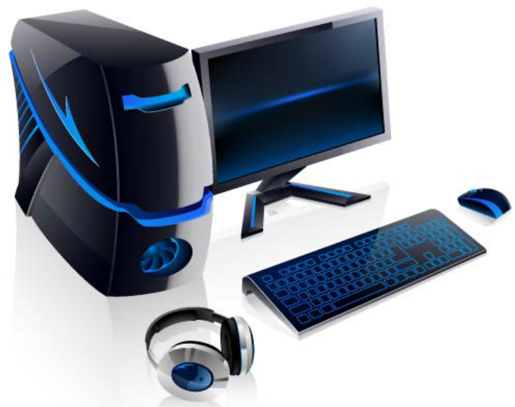
Configurations for Specialized Computer Systems Specialized Computer Systems
Thick and Thin Clients
Thin clients have little processing power and are designed to act as a terminal to a server (thick client).
Thick clients have more powerful CPUs, more memory and their own storage. They serve as processing stations for thin clients.
CAx Workstations
Designed to support CAD and CAM applications.
Plenty of RAM, fast disks, powerful CPU and special input devices are common resources.
Audio and Video Editing Workstations
Common editing workstation resources include much RAM, fast disks, powerful CPU and special adapter cards such as audio and video capture.
Notes:
1.3 - Configurations for Specialized Computer Systems
1.3.1 - Specialized Computer Systems

Slide 26
Configurations for Specialized Computer Systems Specialized Computer Systems (Cont.)
Virtualization Workstations
These workstations are designed to run virtual computers
Virtual computers use and share the workstation’s physical resources such as CPU, memory and disks.
The selection of physical resources will depend on the number and purpose of the virtual machines.
Gaming PCs
Due to high resource requirements of modern games, gaming PCs are very resource demanding.
A few requirements of gaming PCs are: top end CPU, lots of fast RAM, fast disks, high performance input devices and audio systems.
Home Theatre PCs
These computers must be able to play various media formats and, in some cases, receive TV signals.
Common HTPC requirements include powerful CPU, fast RAM, large disks, fast NIC and video card with TV input.
Notes:
1.3 - Configurations for Specialized Computer Systems
1.3.1 - Specialized Computer Systems (Cont.)

Slide 27
1.4 Chapter Summary
Notes:
Cisco Networking Academy Program
IT Essentials
Chapter 1: Introduction to the Personal Computer

Slide 28
Chapter Summary Summary
This chapter introduced the components that comprise a personal computer system and what to consider when choosing upgrade components.
Information technology encompasses the use of computers, network hardware, and software to process, store, transmit, and retrieve information.
A personal computer system consists of hardware components and software applications.
The computer case and power supply must be chosen carefully to support the hardware inside the case and allow for the addition of components.
The internal components of a computer are selected for specific features and functions. All internal components must be compatible with the motherboard.
Use the correct type of ports and cables when connecting devices.
Typical input devices include the keyboard, mouse, touch screen, and digital cameras.
Typical output devices include monitors, printers, and speakers.
Cases, power supplies, the CPU and cooling system, RAM, hard drives, and adapter cards, must be upgraded when devices fail or no longer meet customer needs.
Specialized computers require hardware specific to operate. The type of hardware used in specialized computers is determined by how a customer works and what a customer wants to accomplish.
Notes:
1.4.1.1 - Summary

Slide 30


Slide 31
Section 1.1 New Terms and Commands
adapter
agp
amd
amplifier
analog
architecture
ata
atx
atx12v
backbone
biometric
bios
bit
bnc
bus
byte
cache
capacitors
card
cartridge
case
cathode
chassis
chip
chipset
cisc
coaxial
computer
cooling
cpu
crt
desktop
digital
digitizer
diode
dip
disk
display
displayport
Notes:
New Terms and Commands

Slide 32
Section 1.1 New Terms and Commands (cont.)
dlp
dot pitch
drive
dvd
dvi
eisa
eps12v
ethernet
eufi
fan
firmware
flash
floppy
fps
fsb
gamepads
ghz
gui
hardware
hdd
hdmi
headphones
heatsink
hertz
hub
intel
gpu
grounded
keyboard
kvm
laptop
lasers
lcd
led
lga
mca
mhz
microchannel
micromirror
Notes:
New Terms and Commands (cont.)

Slide 33
Section 1.1 New Terms and Commands (cont.)
microphone
microprocessor
midi
mobile
modem
monitor
monochromatic
motherboard
multicore
nic
nonvolatile
northbridge
ohms
oled
optical
outlets
overclocking
pathways
pcb
pci
pga
pixel
plasma
power
printers
processor
program
qsxga
radiator
radio
ram
rca
resistance
resolution
rgb
risc
rom
rpm
sata
Notes:
New Terms and Commands (cont.)

Slide 34
Section 1.1 New Terms and Commands (cont.)
satellite
scanner
screen
scsi
semiconductor
serial
servers
setup
signal
sink
slot
software
southbridge
speakers
spindle
sram
ssd
ssds
sshd
storage
svga
swappable
switch
tape
terabytes
tft
thunderbolt
transistor
xga
uefi
uid
urls
usb
uxga
vga
volt
Voltage
wattage
watts
Notes:
New Terms and Commands (cont.)

Slide 35
Section 1.1 New Terms and Commands (cont.)
web
webcams
wireless
Notes:
New Terms and Commands (cont.)

Slide 36
Section 1.2 New Terms and Commands
application
autocad
backplane
cds
clock
compactflash
controller
cycle
decoder
dvds
emmc
esata
memory
microsd
mp3
multimediacard
multiplier
pcie
raid
sd
sdhc
sdxc
serial
smartphones
socket
sony
subwoofer
tuner
vrm
workstation
Notes:
New Terms and Commands

Slide 37
Section 1.3 New Terms and Commands
blueprints
cam
cax
cockpit
code
dvi
fat
htpc
linux
mac
mouse
remote
rpm
sdd
server
shares
simulators
ssd
sshd
vdi
virtualization
Notes:
New Terms and Commands

